Slide 1
HelpEx
European Qualification of Ex-Patients in the Helping
Process of Rehabilitation and Recovery
Management of challenges and crises in the process of rehabilitation and recovery
THE CONCEPT OF RECOVERY

Slide 2
THE CONCEPT OF RECOVERY
5.1 PREMISE
The psychiatric assistance must be
Guided by the patient (who control and choose his rehab route)
Individualized and centered on the patient (the recovery routes are various on the base of his unrepeatable need, preferences and experiences)

Slide 3
THE CONCEPT OF RECOVERY
Oriented to give the patient the power to take decisions that will have a deep impact on his life; he must be put in the condition to choose resources and instruments.
Holistic, with an adequate attention to all the parts of the patient (mind, body, spirit and community)
Not linear (the recovery of health it’s a process with phases of growing and crisis)

Slide 4
THE CONCEPT OF RECOVERY
Based on the patient strengths, on his ability to evaluate and build skills (empowerment)
Based on respect
Based on assumption of responsibility by the patient
Based on peer support
Based on hope and trust
(Consensus conference on recovery meaning in mental health in USA – 2006)

Slide 5
THE CONCEPT OF RECOVERY
5.1.a Recovery definition
RECOVERY
“Change process of behaviours, values, targets, skills and roles; a way of life satisfactory, full of hopes and able ti give a support to others despite the illness”.
William A. Anthony - 1993

Slide 6
THE CONCEPT OF RECOVERY
“Recovery is a development process of potential and at the same time a work for a valid social role”.
Mike Slade - 2015
“The recovery experience involves a process for the development of a valid role and of a sense of identity despite the illness”.
Larry Davidson - 2012

Slide 7
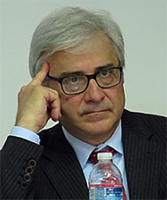
THE CONCEPT OF RECOVERY
“The recovery process underline the passage from healing from a disease to reclaim our own life; it’s the chance that the people have to give a direction to their illness, without being crashed by it”.
Roberto Mezzina - 2015
For every definition it’s important to experience the support to others, which become a well-being factor.

Slide 8
THE CONCEPT OF RECOVERY
DISTINCTION BETWEEN…
Clinical Recovery
Total remission of symptoms and illness
Personal Recovery
Internal and external process that sparks in the patient an active engagement to recover a control of his life and potential

Slide 9
THE CONCEPT OF RECOVERY
5.1.b Elements for recovery starting recognition and following phases of recovery
The start of the recovery process can find a trigger in a positive management of a crisis by the territorial services.
The start of the recovery process it’s a chance to find a new way to redefine himself; new awareness of his condition with a reject of a passive acceptation of the limitations determined by the disease/addiction.

Slide 10
THE CONCEPT OF RECOVERY
It’s possible to win back an identity, starting from the description of his own sufferings to learn how to face them: accept that “I’m not my illness”.
Wilma Boevink - 2011

Slide 11
THE CONCEPT OF RECOVERY
THE RECOVERY PROCESS START
The healing process is lighted by the acceptation of limitations: accepting what isn’t possible is possibile to discover what is possibile.
This perspective change gives importance to the real value of experiences.

Slide 12
THE CONCEPT OF RECOVERY
Awakening of hope after years of despair
Desire to excape from isolation and attempt to be part of social life
Being ready to try, fail and try again
Chance to find someone that never start hoping, calling, encouraging, and who manage to stay optimistic; it’s not sure that this person is a professional

Slide 13
THE CONCEPT OF RECOVERY
RECOVERY PHASES
SUSPENSION
The patient lives a period of isolation with a deep sense of loss and desperation
AWARENESS
The patient sees that non everything is totally lost; a full life is still possible
PREPARATION
Taking note of strengths and weaknesses; work together to develop abilities.

Slide 14
THE CONCEPT OF RECOVERY
RECONSTRUCTION
Work for the development of a sense of positive identity; find meaningful targets and take control of his life
GROWING
The patient’s life is enriched by other meanings (“I’m not my illness/addiction”);
Autonomous management of the sufferings.

Slide 15
THE CONCEPT OF RECOVERY
5.1.c Common elements in various recovery routes and subjective and objective signs
COMMON ELEMENTS IN VARIOUS RECOVERY ROUTES
Reprise of expectations for the future
Overcoming of illness denial
Acceptation of the new condition
Involvement
Active behaviour
Claim of a positive sense of himself

Slide 16
THE CONCEPT OF RECOVERY
COMMON SUBJECTIVE SIGNS IN RECOVERY ROUTES
Some signs are subjectively perceived by patients.
Existence of life projects
Trust in his initiative skills
Pleasant management of free time
Harmony with the environment
Sensation of vital well-being
Self-esteem
Perception of the future
Reduction of internal stigma

Slide 17
THE CONCEPT OF RECOVERY
COMMON OBJECTIVE SIGNS IN RECOVERY ROUTES
Other signs are more objective.
Discovery of a valid and satisfying role
Building of meaningful relations
Reduction or control of symptoms
Emprovement of physical health

Slide 18
THE CONCEPT OF RECOVERY
5.1.d Key elements in recovery facilitation
Participation of patient and of their families in recovery process: the main experts of needs and of the rebuilding of their own life are the patients
Facilitation in care access: favor a quick and simple entry in care system, removing bureaucratic barriers
Going where the patient is: better than forcing the patient to reach the services

Slide 19
THE CONCEPT OF RECOVERY
Recovery is a long term process: the care and the therapies are not only for the crisis phases, but for a continuous take in charge
Recovery favors empowerment and conditions of equal opportunities also for people with psychical disease or with addiction problems
Every intervention is based on an individualized plan
Promotion of peer support: better communication also through the use of more immediate and shared talking

Slide 20
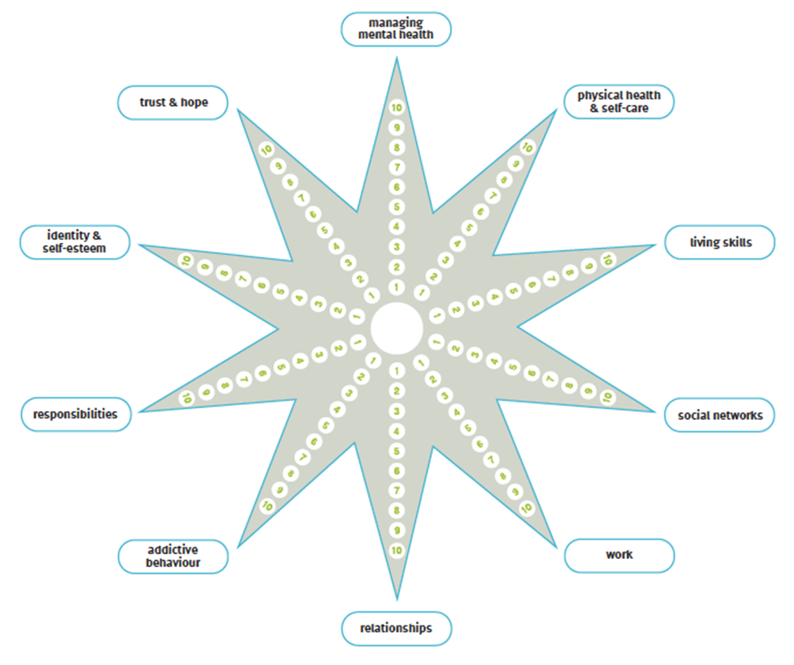
THE CONCEPT OF RECOVERY
RECOVERY STAR
It’s a tool elaborated by Triangle Consulting in 2011 on mandate by Mental Health Providers Forum.
Its goal is provide a support to patients and his therapists in definition, monitoring and evaluation of care and rehab strategies.

Slide 21
THE CONCEPT OF RECOVERY
The star evaluates 10 areas:
Mental health
Life skills
Work
Addictions
Responsibility
6. Social networks
7. Personal relations
8. Hope
9. Self-care
10. Identity and self-esteem

Slide 22
THE CONCEPT OF RECOVERY
It’s an extremely flexible tool
The operators are trustful for patient’s potential in approach based on strengths more than weaknesses
Promote a partnership relation between operators and patients
Favors the development of training and refreshing courses integrated about recovery themes

Slide 23
THE CONCEPT OF RECOVERY
It’s vital to be aware of territorial services and resources, but also of its obstacles
The community development based on resources can help people labeled or marginalized: they can be part of community life as citizens and not as disabled.
Support for the building of significant relation around the patient, favouring the reconstruction of social bounds.

