Slide 1
The many faces of depression

Slide 2
Marilyn Monroe actress, singer
Died on the 4th August 1962 by suicide at age 36

Slide 3
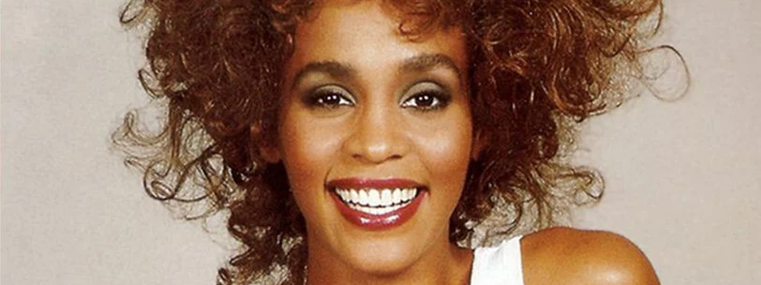
Whitney Houston singer
Died on the 11th February 2012 by suicide at age 48

Slide 4
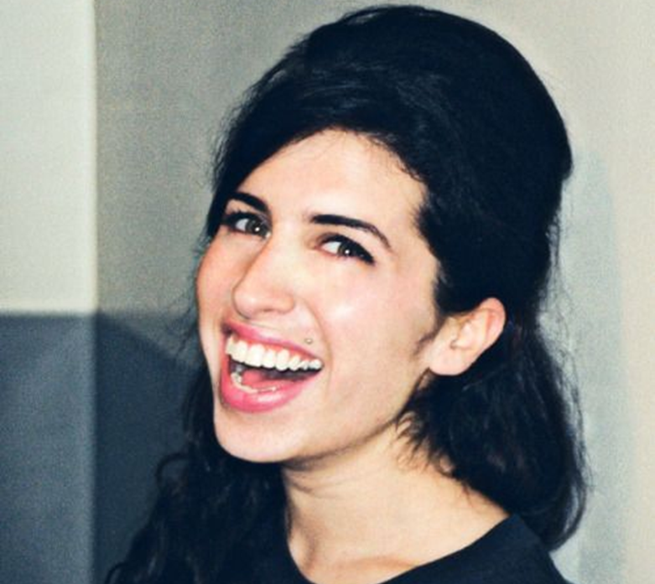
Amy Whinehouse singer
Died on the 23rd July 2011 by suicide at age 27

Slide 5
Anthony Bourdain world-renowned chef
Died on the 8th June 2018 by suicide at age 61

Slide 6
Tim Bergling (AVICII) DJ
Died on the 20th April 2018 by suicide at age 28

Slide 7
Chris Cornell Rock icon
Died on the 18th May 2017 by suicide at age 52

Slide 8
Robin Williams actor
Died on the 11th August 2014 by suicide at age 63

